Slide 1
Python Tkinter Advanced Widgets
Session 17

Slide 2
Objectives
Menu & PopupMenu in Tkinter
Spinbox, Scale & Scrollbar in Tkinter
Listbox & Treeview in Tkinter
Tabbed in Tkinter

Slide 3
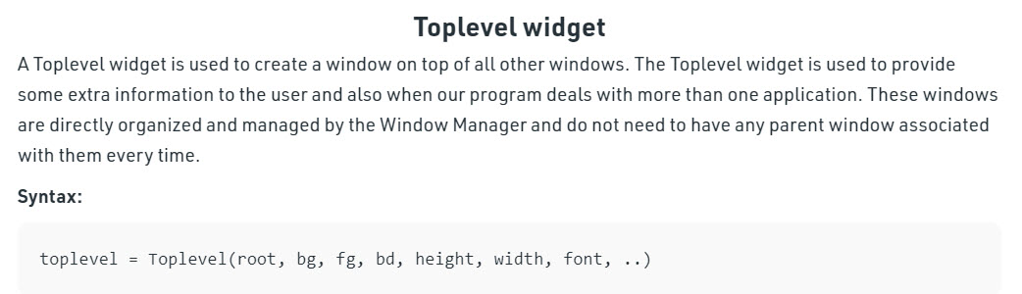
Python Tkinter – Toplevel Widget

Slide 4
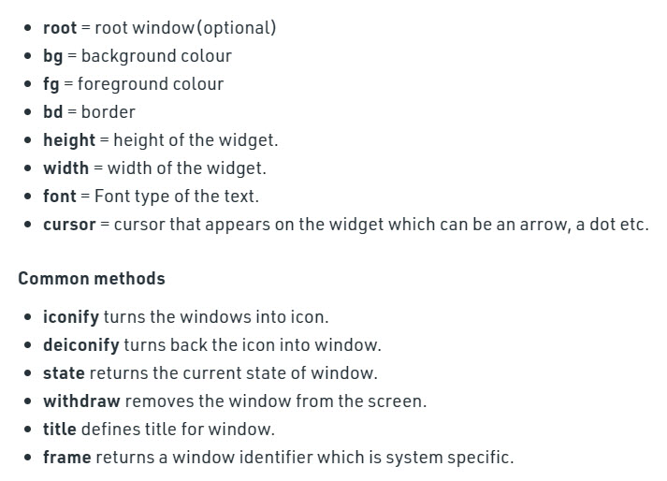
Python Tkinter – Toplevel Widget

Slide 5
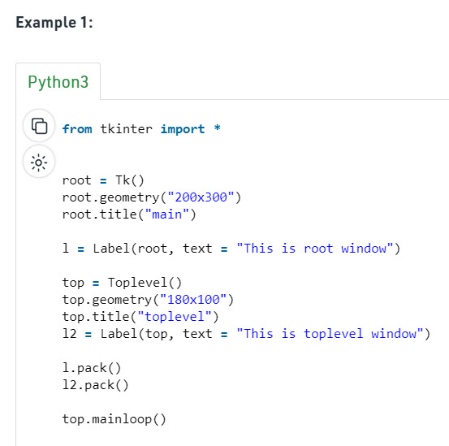
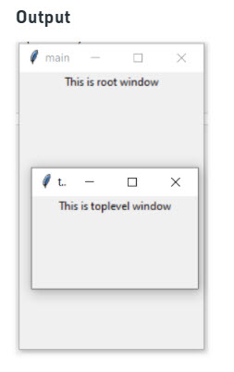
Python Tkinter – Toplevel Widget

Slide 6
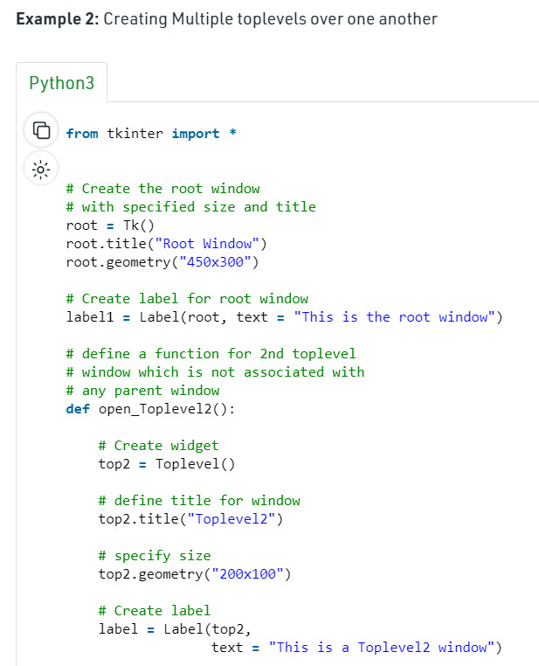
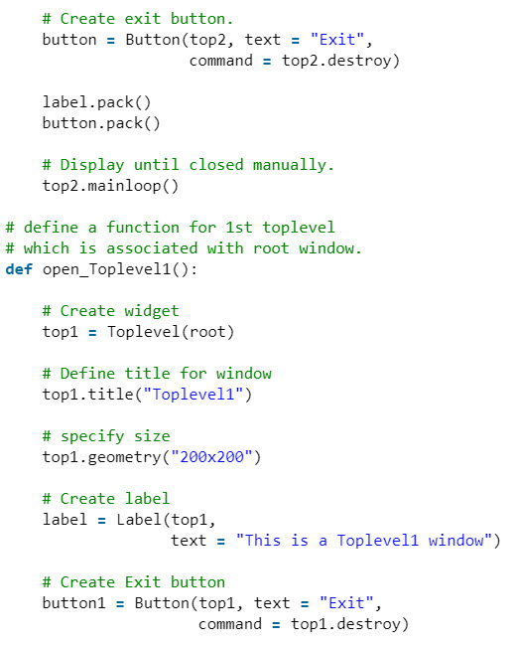
Python Tkinter – Toplevel Widget

Slide 7
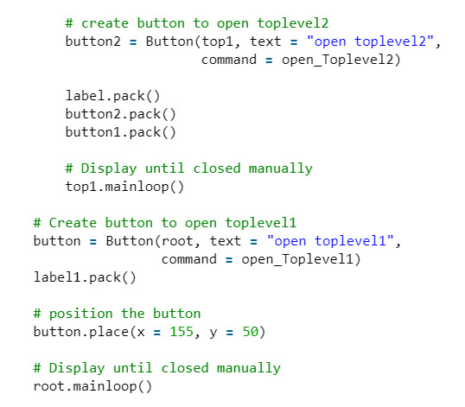
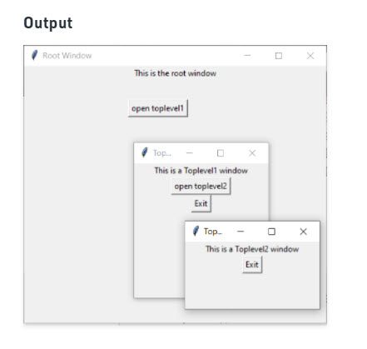
Python Tkinter – Toplevel Widget~

Slide 8
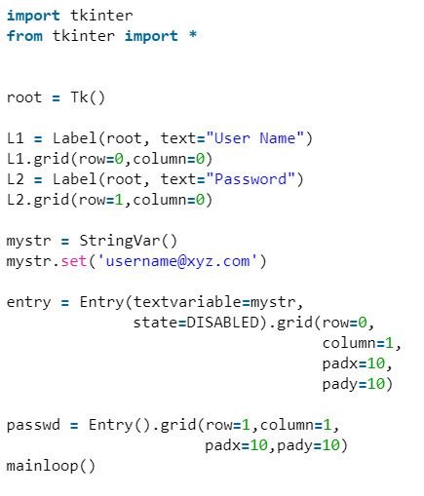
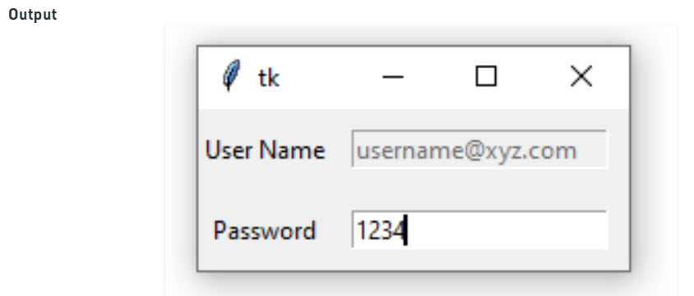
Read only Entry Widget

Slide 9
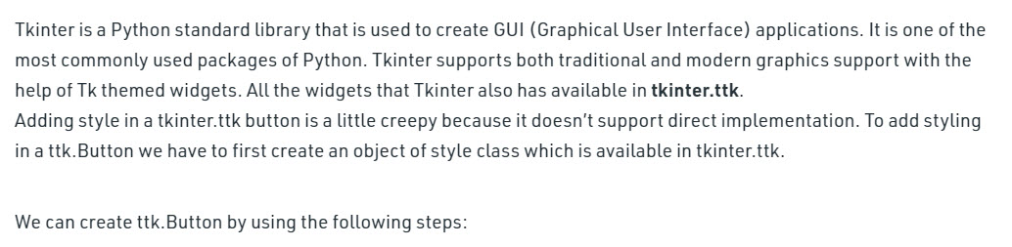
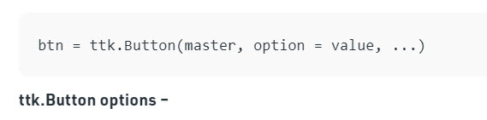
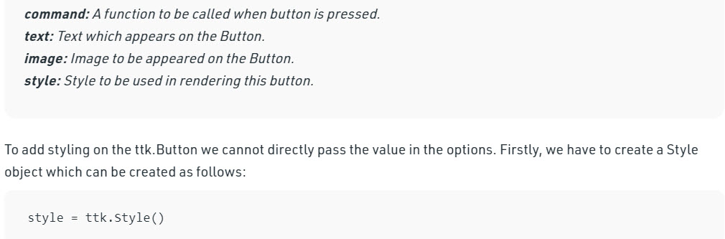
Add style to tkinter button

Slide 10
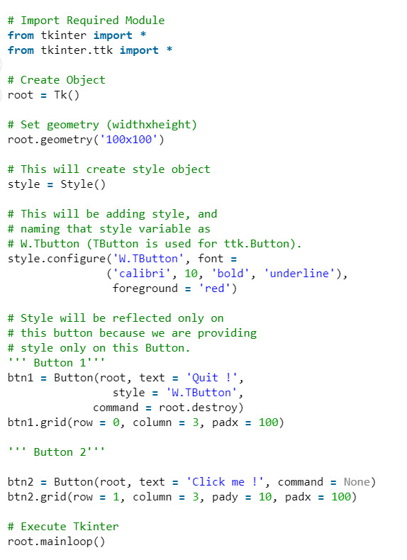
Add style to tkinter button

Slide 11
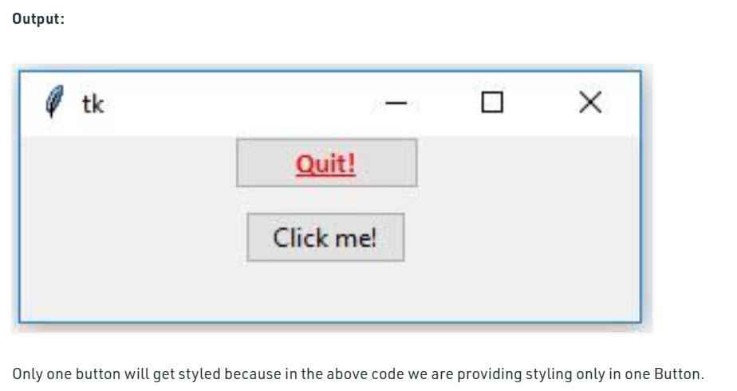
Add style to tkinter button

Slide 12
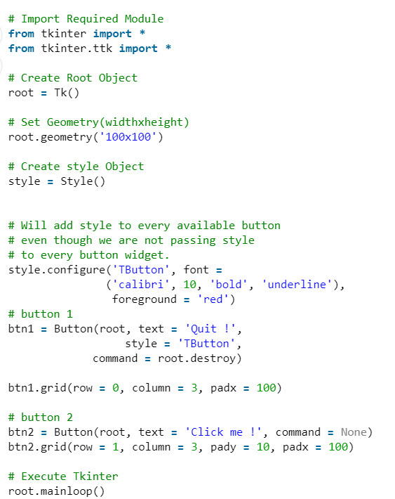
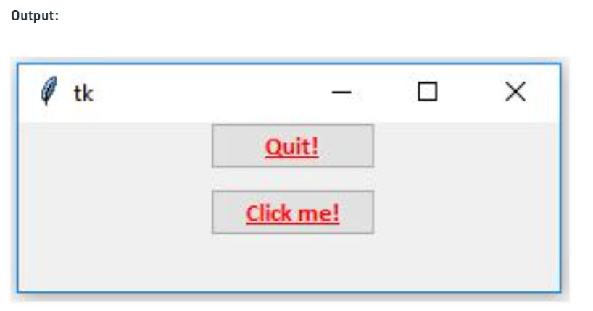
Add style to tkinter button

Slide 13
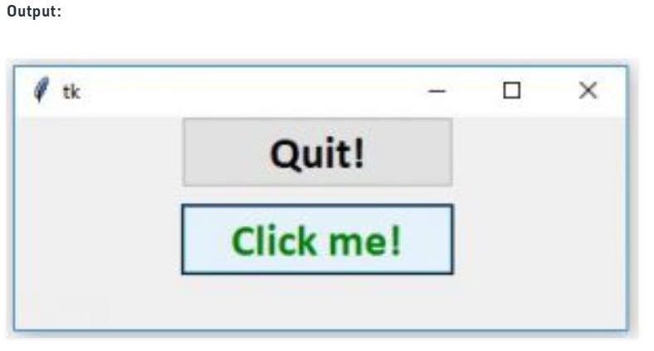
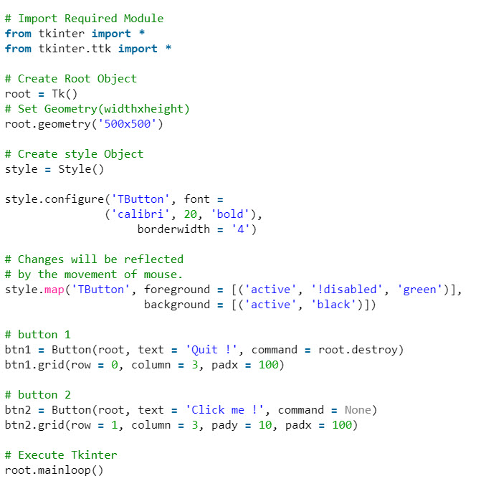
Add style to tkinter button

Slide 14
Summary
Menu & PopupMenu in Tkinter
Spinbox, Scale & Scrollbar in Tkinter
Listbox & Treeview in Tkinter
Tabbed in Tkinter

